Slide 1





Group Number::21
Count Number Of Objects In Image
Supervised by: Dr. Rashi Jaiswal
Ranveer Rathour
Punnya P Gaur
Prakhar Verma

Slide 2





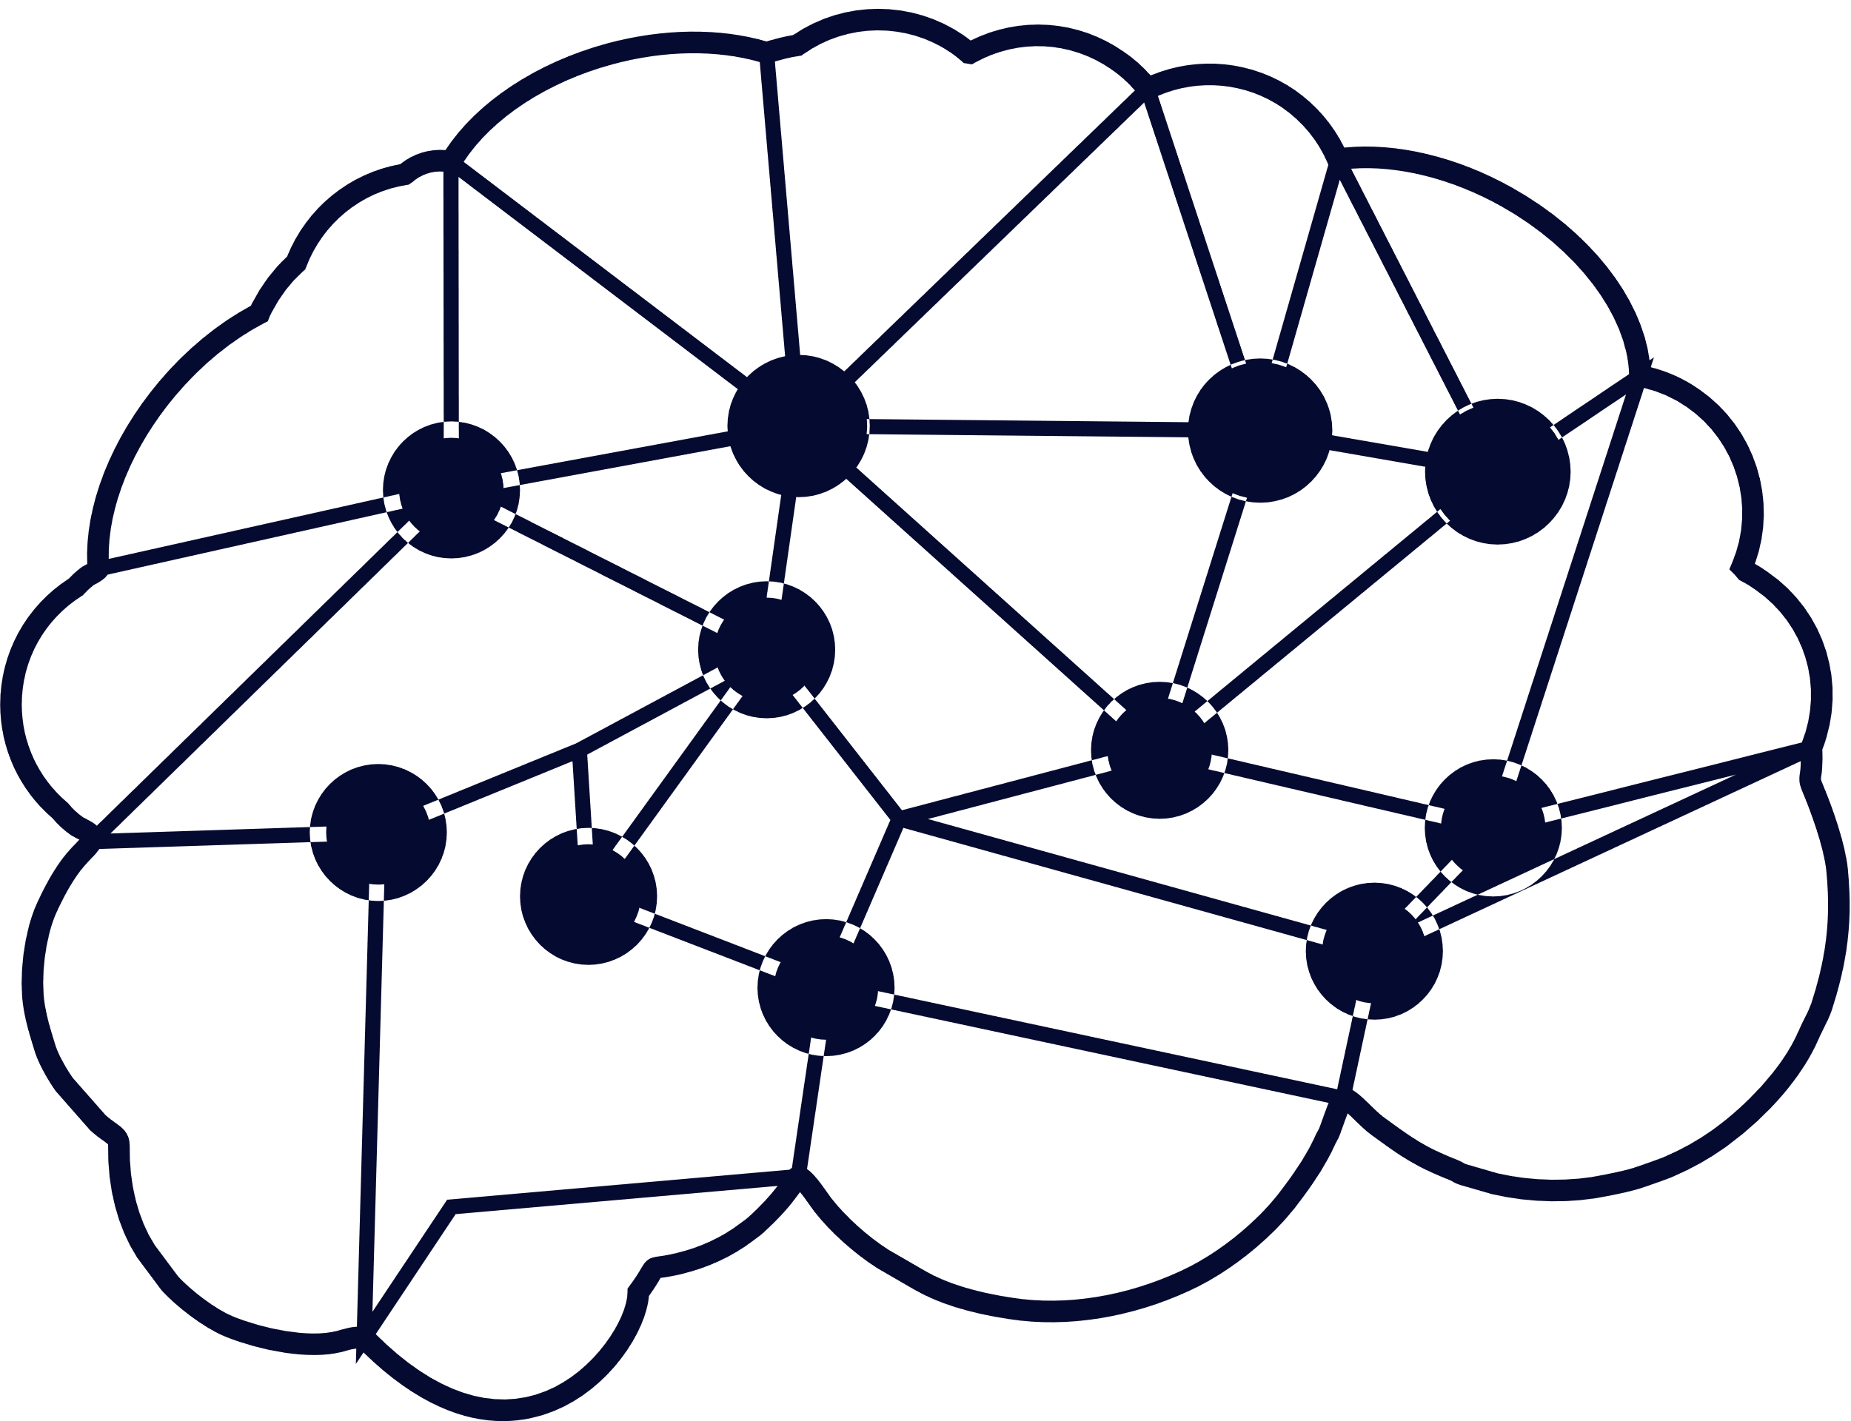
Index of Presentation
01
Introduction
04
Results
02
Understanding the problem Statement
05
Future Work
03
Model Working
06
References

Slide 3




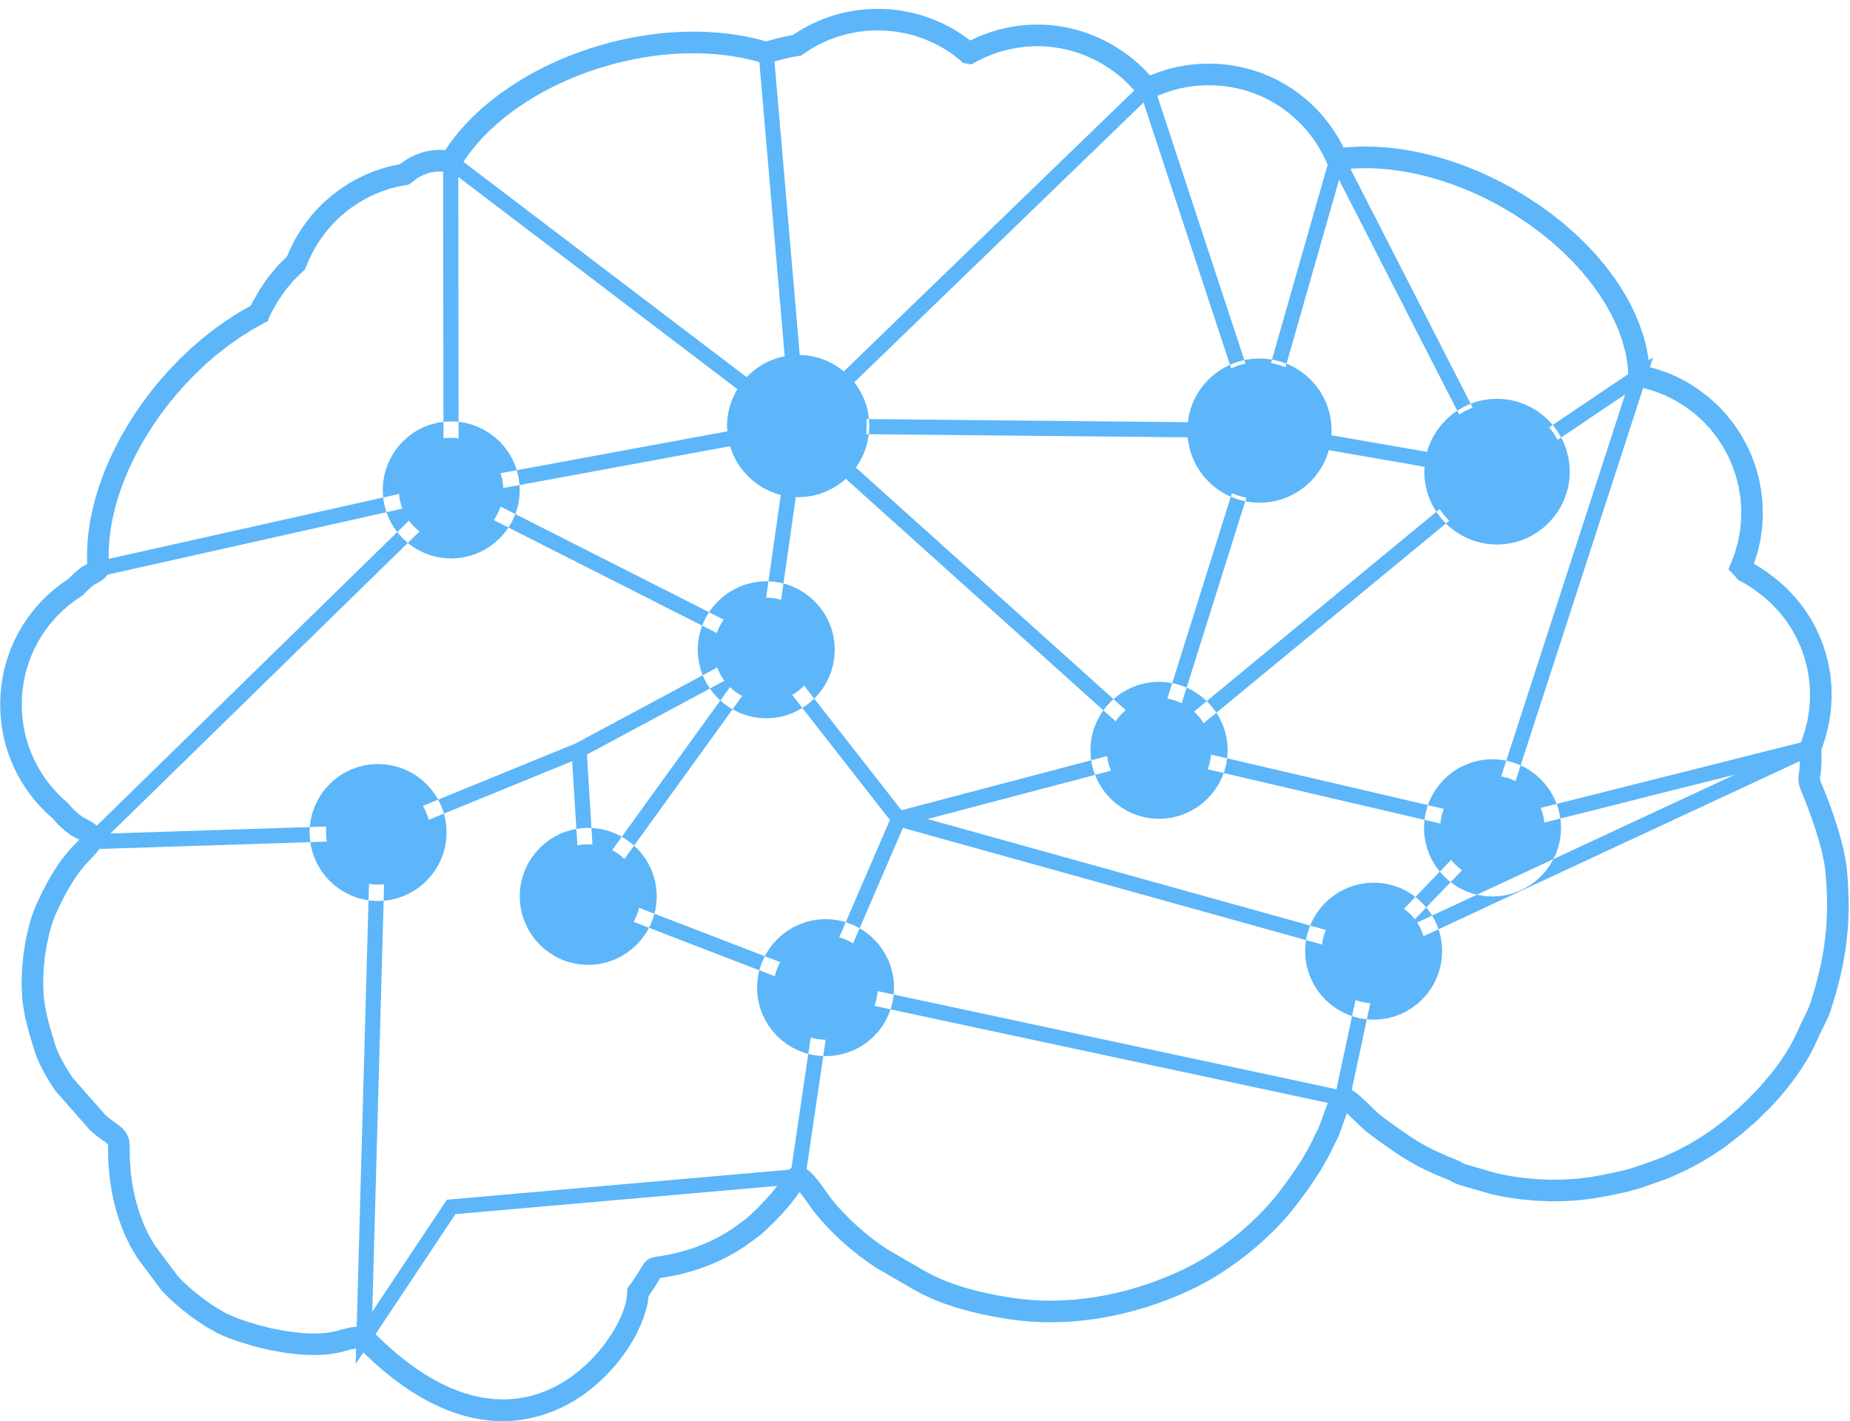

Introduction
Object detection is a phenomenon in computer vision that involves the detection of various objects in digital images or videos. Some of the objects detected include people, cars, chairs, stones, buildings, and animals.
What is YOLO:-YOLO is an algorithm that uses neural networks to provide real-time object detection. This algorithm is popular because of its speed and accuracy. It has been used in various applications to detect traffic signals, people, parking meters, and animals.
YOLO algorithm has gained popularity because of its superior performance over the aforementioned object detection techniques.

Slide 4
Understanding the problem statement
.
Object detection is a computer technology related to computer vision and image processing that deals with detecting instances of semantic objects of a certain class (such as humans, buildings, or cars) in digital images and videos.^{[1]} Well-researched domains of object detection include face detection and pedestrian detection. Object detection has applications in many areas of computer vision, including image retrieval and video
We propose a new supervised learning framework for visual object counting tasks, such as estimating the number of cells in a microscopic image or the number of humans in surveillance video frames. We focus on the practically-attractive case when the training images are annotated with dots (one dot per object)

Slide 5

Methodology & Pretrained Algorithms.
RCNN(2014):Works on region based CNN.
FAST R-CNN(2015): Selective search for regions of Interest.
FASTER R-CNN(2016):Region Proposal Network(RPN)
SSD(2016):Completely eliminates proposal generation and subsequent
pixel and encapsulate all computation in a single network.
YOLO(2016): Accomplish Object Detection via fixed grid regression

Slide 6
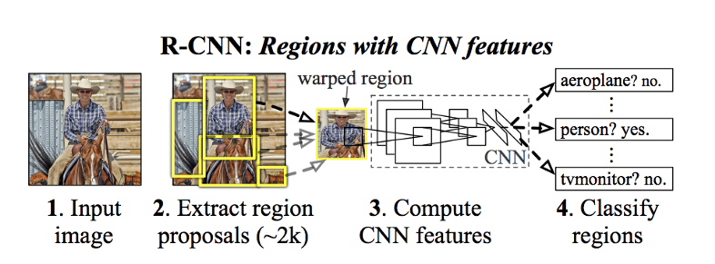
Region-Convolutional Neural Network

Slide 7
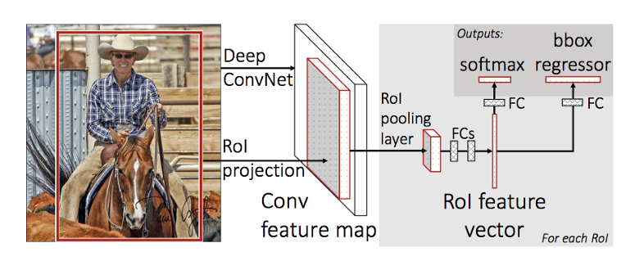
FAST R-CNN

Slide 8
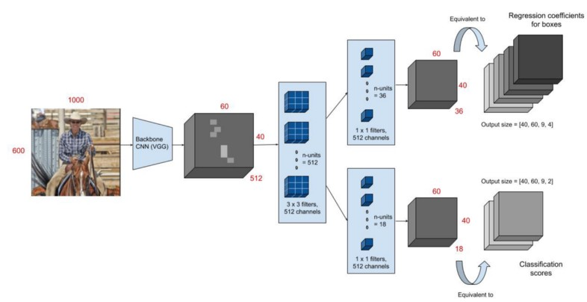
FASTER R-CNN

Slide 9
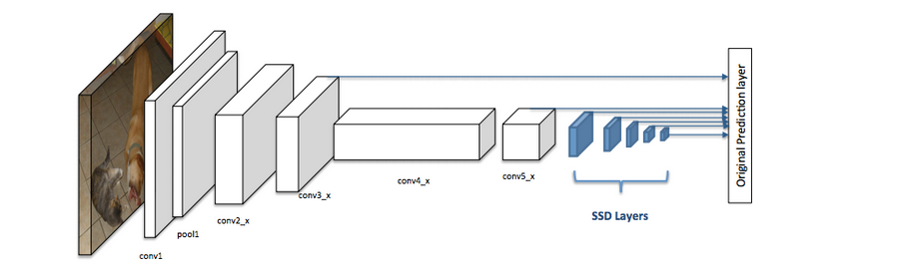
SSD: Single Shot

Slide 10
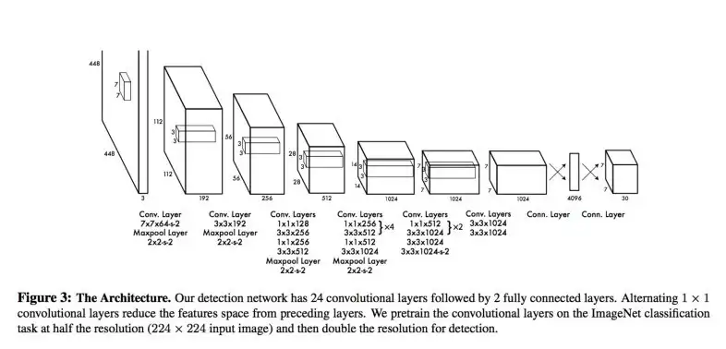
YOLO : YOU LOOK ONCE

Slide 11


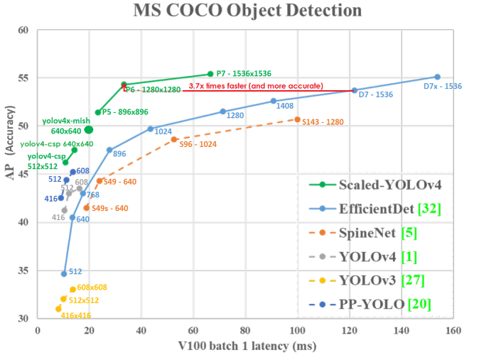

Difference b/w Yolo & Other Models

Slide 12
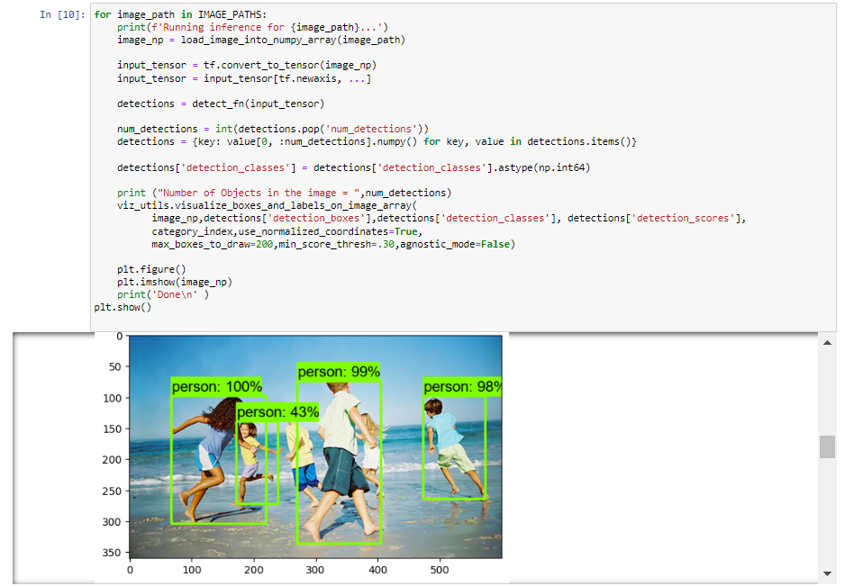
CODE

Slide 13

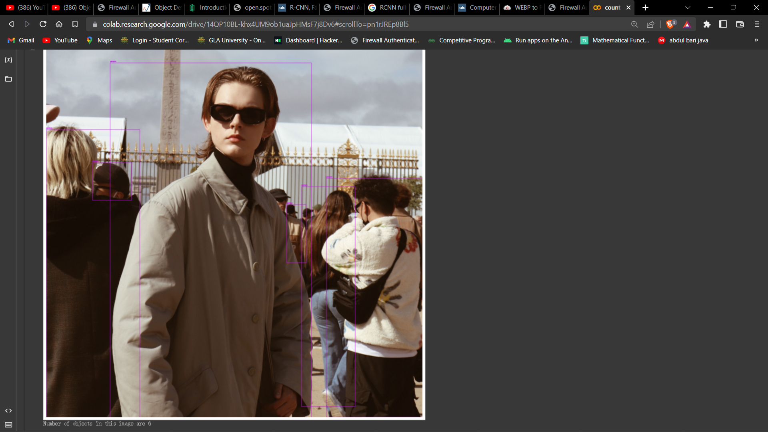
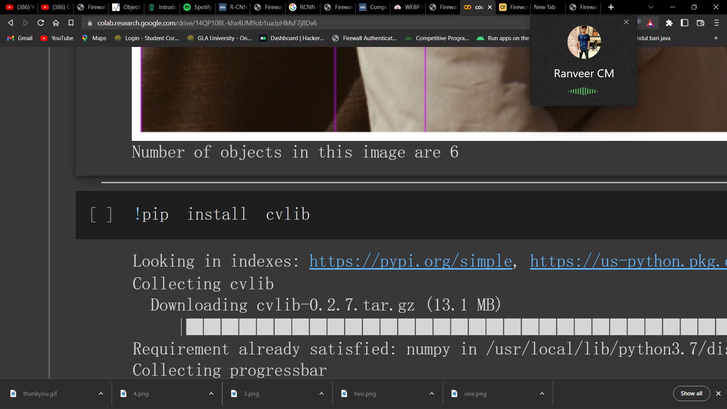
Results
Original Image

Slide 14
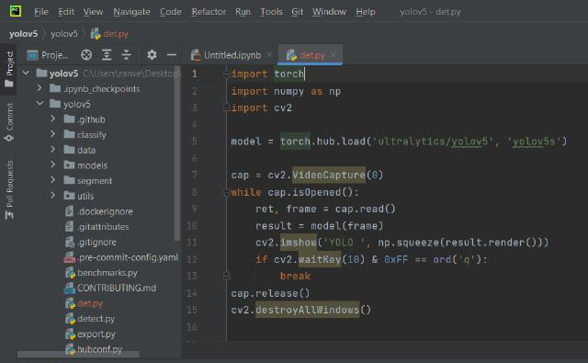
CODE

Slide 15
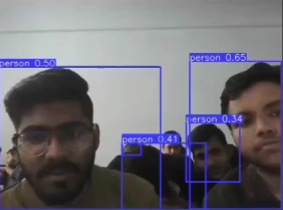
Results

Slide 16


Future Scope
Visual AI in Healthcare
Security and surveillance
Hospitals and clinics use it to detect and track medical equipment, supplies, and patients. This helps to keep track of everything that is going on in the hospital (patient movement), allows for more efficient inventory management, and improves patient safety.
Object detection is used in security and surveillance to identify and track objects in a given area. This can be used for security purposes, such as identifying potential threats, or for tracking the movements of people or objects in a pre-defined space (perimeter monitoring). Object detection is also an integral part of many facial recognition systems.
Autonomous Vehicles
Smart city and traffic management
YOLOv7 enables object detection as used in traffic management systems to detect vehicles and pedestrians at intersections.
Object detection is a key technology for self-driving cars where it is used to detect other vehicles, pedestrians, and obstacles automatically. AI vision is also used in Aviation, for autonomous drones, asset management, or even missile technologies

Slide 17
References
[1] https://github.com/AlexeyAB/
[2] https://www.analyticsvidhya.com/blog/2020/04/build-your-own-object-detection-model-using-tensorflow-api/
[3] https://towardsdatascience.com/computer-vision-instance-segmentation-with-mask-r-cnn-7983502fcad1
[4] https://www.youtube.com/watch?v=ATw1Dy4p1GU
[5]https://colab.research.google.com/drive/19TUG1suBe64_LcnA_ege4MEN_iVo5hXC
[6] https://icons8.com/illustrations

Slide 18




Thank You

